Slide 1
DeepAR for Time Series Forecasting
Notes:
Welcome back to Module 2 on Amazon SageMaker and DeepAR for Time Series Forecasting.

Slide 2

Topics
Amazon SageMaker DeepAR
LSTM-parameterized Likelihood
Monte Carlo Simulation
Lab: DeepAR for Forecasting
Notes:
This module starts off with a review of Amazon SageMaker, followed by a deep dive into the DeepAR algorithm. By the end of this module, you will have an opportunity to use DeepAR in a hands-on lab. The goal of this module is to prepare you to use Amazon SageMaker and DeepAR to apply forecasting to your own time series.

Slide 3
The Seminal Work on DeepAR
Research Paper
DeepAR: Probabilistic Forecasting with Autoregressive Recurrent Networks
Authors
Valentin Flunkert, David Salinas, and Jan Gasthaus
Notes:
Before discussing the features of DeepAR, it is important to reference the original research that led to the development of the algorithm. This work is published in “DeepAR: Probabilistic Forecasting with Autoregressive Recurrent Network” by Valentin Flunkert, David Salinas and Jan Gasthaus.
Some content in this module section is based on information from the research paper. You can download the research from: DeepAR: Probabilistic Forecasting with Autoregressive Recurrent Network.

Slide 4

Introduction to Amazon SageMaker DeepAR
Supervised learning algorithm based on autoregressive RNNs that can produce both point and probabilistic forecasts
Consists of LSTM Networks and Monte Carlo Simulation
Notes:
DeepAR is a supervised learning algorithm for time series forecasting that uses recurrent neural networks, specifically Long Short-Term Memory networks, to produce both point and probabilistic forecasts. DeepAR is essentially a combination of LSTM networks and Monte Carlo simulation, which is a common probability simulation used in forecasting models.
Classical forecasting methods, such as Autoregressive Integrated Moving Average (ARIMA) or Exponential Smoothing (ETS), fit a single model to each individual time series, and then use that model to extrapolate the time series into the future. In many applications, however, you encounter many similar time series across a set of cross-sectional units. Examples of such time series groupings are demand for different products, server loads, and requests for web pages. In this case, it can be beneficial to train a single model jointly over all of these time series. DeepAR takes this approach, outperforming the standard ARIMA and ETS methods when your dataset contains hundreds of related time series. The trained model can also be used for generating forecasts for new time series that are similar to the ones it has been trained on.

Slide 5
DeepAR: Feature Engineering, Missing Value Support
Historical Data
Forecast Data
Example of missing value
Time
Notes:
In the previous module section, you just learned about the management that Amazon SageMaker provides. However, for forecasting algorithms, further time series feature engineering is required. DeepAR handles much of this. Other forecasting algorithm implementations assume that data is complete. Reality tends to disagree.
In practice, time series data is often only partially observed. For example, a time series may contain sensor data, and that sensor might be out of order or offline for a given time; a product might be out of stock when predicting demand, or the traffic time series information of a server might be unavailable for several days due to downtime or misconfiguration. In such cases, the burden often lies on the user who has to fill (impute) the missing values before using the forecasting algorithm. However, incorrectly imputed data can have detrimental effects on the forecast. For example, if you replace unobserved values by zeros in out-of-stock situations, the forecasts will be biased down toward zero. Surely, this is unwanted if you want to predict future product demand, especially after long out-of-stock phases.
The latest release of DeepAR now handles missing values directly within the model. This makes forecasting with time series that contain missing values easier (no imputation during pre-processing is required) and more accurate (by utilizing the RNN model instead of relying on coarse-grained external imputation techniques).

Slide 6
DeepAR: Feature Engineering, Custom Feature
Historical Data
Forecast Data
Feature
Time
Notes:
When forecasting a time series, you often have other explanatory time series that can provide useful information about the target time series. For instance, when predicting demand for a product, you might have access to time-dependent information, such as whether a promotion has been in effect during a certain period of time or what the price of the product was. With DeepAR you can provide your own feature time series to model custom seasonality patterns, causal effects, and more (in addition to the default seasonality features that DeepAR provides internally). Using this time-varying information can ultimately improve accuracy by “explaining” effects that otherwise would have to be attributed to noise. In addition, you can simulate “what if” scenarios, for example, “What happens if I promote this item in the future for one week?”.

Slide 7
DeepAR: Feature Engineering, Multiple Categories
Associate your time series with multiple groupings
1. High-level group: Clothing
Shoe Sales
2. Low-level group: Shoes
3. Low-level group: [Brand of Shoe]
Time
Notes:
When forecasting a given time series, group information can be very helpful, especially when there is not much historical data available. DeepAR previously supported grouping time series by a single categorical grouping attribute, allowing users to encode one possible grouping of the time series. In practice, time series are often associated with not just one but multiple groupings that can be leveraged for extracting fine-grained group-level effects, such as seasonality patterns. For example, when forecasting the demand for a product, the product might be part of multiple groups: It might be associated with a high-level group such as “clothing” (instead of “electronics”), or lower-level product groups such as “shoes” (instead of “t-shirts”) or “flip-flops” (instead of “sneakers”). Or it might be a group that is associated with the product brand. Or it could be a group associated with the store the product is sold at, and so on.
Support for multiple groupings is one of the features the new release of DeepAR now supports. The grouping information can now be encoded into multiple categorical features, one per grouping, and supplied to DeepAR as a vector of integers per time series. By making use of this grouping information, DeepAR can learn group-specific behavior such as seasonality patterns, ultimately increasing forecast accuracy.

Slide 8
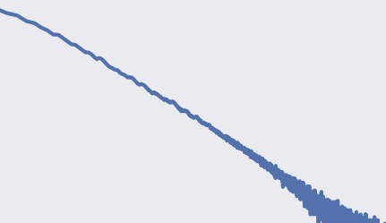


DeepAR: Feature Engineering, Scaling
Non-linearity and sample imbalances result in loss of scale
Solution:
Divide AR inputs by item-dependent scale factor $v_{i}$
Multiple scale-dependent likelihood by the same factor
$$v_{i}=1+\frac{1}{t_{0}}\sum_{t=1}^{t_{0}}{z_{i,t}}$$
log(# items)
Power-Law
log(# sold)
Notes:
Real-world data can exhibit power-law relationships. For example, often in sales distributions you see that very few items sell exponentially high, and conversely, exponentially, many items have low sales volume.
Many items with low sales means many samples of short data histories. And the few items with high sales, mean few samples with long data histories. This poses two challenges: (1) exponentially autoregressive non-linearities, and (2) imbalanced sample sizes of the data series. Item-dependent scaling proves critical in overcoming both.
(1) The more an item starts to sell, the likelier it is to sell exponentially more. The output has a non-linear (power-law) scaling with respect to its autoregressive input. However, the non-linearity modeling within the neural network operates in a more limited range. The neural network will not learn the exponential linearities efficiently, especially when there few samples of those series.
DeepAR’s item-dependent scaling is where the autoregressive inputs $z_{i,t}$ are by an item-dependent scale factor $v_{i}$. The neural network is then trained on scaled series, and the outputted likelihood parameters are then unscaled by multiplication of the respective scaling factors. This arithmetic handles power-law dynamics much more efficiently than letting a neural network train further epochs, which may still not recover correct scale.
(2) The second challenge mentioned is the sample imbalance in the data. DeepAR uses the item-dependent scale factor $v_{i}$ to ensure the probability of selecting a window from item series $i,$proportional to $v_{i}$. This is different from uniform sampling, which will not visit the few large-scale series frequently enough, and therefore underfit those time series.
To learn more about the way DeepAR handles scaling, download DeepAR: Probabilistic Forecasting with Autoregressive Recurrent Network and refer to Section 3.4.

Slide 9
DeepAR: Cold Start Forecasting
Historical Data
Forecast Data
Time
Time
Time
Historical data from similar products used to…
…forecast sales of new product with little to no history
Notes:
And for a final highlight of a DeepAR benefit, consider cold start forecasting. A cold start scenario occurs when you want to generate a forecast for a time series with little or no existing historical data. This occurs frequently in practice, such as in scenarios where new products are introduced or new AWS Regions are launched. Traditional methods such as ARIMA or ES rely solely on the historical data of an individual time series, and as such they are typically less accurate in the cold start case. Consider the example of forecasting clothing items such as sneakers. A neural network-based algorithm such as DeepAR can learn typical behavior of new sneaker sales based on the sales patterns of other types of sneakers when they were first released. By learning relationships from multiple related time series within the training data, DeepAR can provide more accurate forecasts than the existing alternatives.

Slide 10



DeepAR Model
Goal: Given observed values of a series, in dimension d, for t time-steps, estimate probability distribution of next T steps.
$$\prod_{t=t_{0}}^{T}{l(z_{d,t}|θ\left(h_{d,t},Θ\right)})$$
Probability
distribution
$P(Z_{d,t_{0}:T}|Z_{d,{1:t}_{0},}X_{i,1:T})$ =
Likelihood
parameterized by
the output of a LSTM-RNN
$$h_{d,t}=h(h_{d,t−1},z_{d,t−1},x_{d,t},Θ)$$
Notes:
Now, to formally state the goal of DeepAR’s model: given observed values of a series, in dimension d, for t time-steps, estimate probability distribution of next T steps.
On the left-hand side, you see the probability distribution that is being targeted for estimation. On the right-hand side, you see the probability distribution is reformulated in terms of its per-timestep likelihoods.
Notice that DeepAR is modeling the parameters of the likelihood as outputs of a hidden layer of an RNN, specifically an LSTM-RNN.

Slide 11

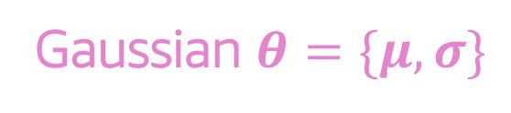
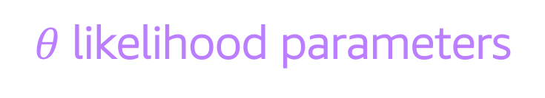


DeepAR Likelihood Model: Gaussian
For real-valued data
$θ$likelihood parameters
$$l_{G}\left(z | μ,σ\right)=\frac{1}{\sqrt{2πσ^{2}}}e^{\left\{\frac{−{(z−μ)}^{2}}{2σ^{2}}\right\}}$$
Gaussian $θ=\{μ,σ\}$
LSTM is being trained to learn these values
$$μ\left(h_{d,t}\right)=w_{μ}^{T}h_{d,t}+b_{μ}$$
1 activation function
per
likelihood parameter
$$σ\left(h_{d,t}\right)=\log{(1+e^{(w_{σ}^{T}h_{d,t}+b_{σ})})}$$
e.g., softplus activation
Notes:
Here is an example. For the forecast you want to run, you’re interested in quantifying the confidence of the estimates produced. This leads to, as discussed in Module 1, a probabilistic-approach to forecasting. Additionally, the data you’re working with is real-valued, so you’ll opt for the Gaussian likelihood.
Theta represents the parameters of the likelihood. In the case of Gaussian, theta will represent the mean, mu, and the standard deviation, sigma.
The neural network’s last hidden layer results in $h_{d,t}$. This $h_{d,t}$ will undergo 1 activation function per likelihood parameter. For example, for the Gaussian likelihood, $h$ is transformed by an affine activation function to get the mean, and then $h$ is transformed by a softplus activation to get the standard deviation.
The activation parameters are the parameters within the activation functions. The neural network is going to be trained to learn the fixed constants of the activation parameters. Since the $h$ output will vary given its input, the likelihood parameters will vary over time, and therefore capture dynamic behaviors in the time series data.

Slide 12








DeepAR Model Architecture: Training
Training
$$z_{d, t−1}$$
$$z_{d, t}$$
Data
Outputs
$θ_{d, t−1}$=$\underset{θ}{argmax}{ l\left(z|θ(h,Θ)\right)}$
$$θ_{d, t}$$
$$h_{d,t−1}$$
$$h_{d,t}$$
LSTM
Inputs
$$z_{d,t−2}$$
$$z_{d,t−1}$$
Notes:
This and the next slide zooms out to look at the whole DeepAR model architecture to see how the LSTM-trained activation parameters can produce probabilistic forecasts. This slide focuses on training.
As was pointed out earlier, the input at each time-step is the data point preceding the current time-step’s data, as well as the previous network’s output. For simplicity, on this diagram, the covariates aren’t being shown, which would, if present, also be inputs.
The LSTM layers are shown in red, and the final hidden layer produces the $h_{d,t}$ value, which as we saw in the previous slide will undergo an activation function for each parameter of the specified likelihood. To learn the activation function parameters, the neural network takes the $h_{d,t}$ at time t and the data up until time t, and performs Stochastic Gradient Descent (SGD) to yield the activation parameters which maximize the likelihood at time t.
The blue output layer uses the SGD-optimized activation functions to output the maximum likelihood parameters.
This is how DeepAR trains its model to your data input.

Slide 13








DeepAR Model Architecture: Forecasting
Training
Forecasting
$$z_{d, t−1}$$
$$z_{d, t}$$
$${\tilde{z}}_{d,t+1}^{1:N}$$
$${\tilde{z}}_{d,t+2}^{1:N}$$
Data
Samples
Monte Carlo simulation
Outputs
$θ_{d, t−1}$=$\underset{θ}{argmax}{ l\left(z|θ(h,Θ)\right)}$
$$θ_{d, t}$$
$$θ_{d, t+1}$$
$$θ_{d, t+2}$$
$$h_{d,t−1}$$
$$h_{d,t}$$
$$h_{d,t+1}$$
$$h_{d,t+2}$$
LSTM
Inputs
$$z_{d,t−2}$$
$$z_{d,t−1}$$
$$z_{d,t}$$
$${\tilde{z}}_{d,t+1}^{1:N}$$
Notes:
Continuing with the same example, now you want DeepAR to give you probabilistic forecasts for the next time-step.
The dashed pink vertical line marks the current point in time, dividing the training data from data not yet seen. For the first input, it can use the data point of the current time. The input will be processed by the trained LSTM layers, and subsequently get activated by the optimized activation functions to output the maximum-likelihood theta parameters at time $t+1$.
Now that DeepAR has completed the likelihood with its parameters, DeepAR can simulate Monte Carlo samples from this likelihood and produce an empirical distribution for the predicted data point. The next slides dive into Monte Carlo, but for now note that the samples produced at time $t+1$ are used as input for time $t+2$, etc., until the end of the prediction horizon.
To learn more about the DeepAR architecture, download DeepAR: Probabilistic Forecasting with Autoregressive Recurrent Network and refer to Figure 2.

Slide 14


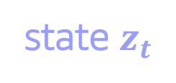
Monte Carlo Simulation
Closed-form Likelihood
$$l\left(x_{t_{0}:T}|θ \right)=\prod_{t=t_{0}}^{T}{l(x_{t}|θ)}$$
Evolves according to a complex, non-linear process…
…becomes intractable
state $z_{t}$
$$t$$
Time
Notes:
Now, take a look at Monte Carlo simulation and how the number of samples simulated affects the accuracy of the model.
Monte Carlo is a method of obtaining numerical results by means of repeated random sampling.
When a state evolves according to a complex, non-linear process, like the sequences earlier slides in this bootcamp have covered, updating the closed-form likelihood of the state at each time-point becomes intractable.

Slide 15
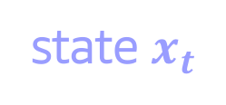
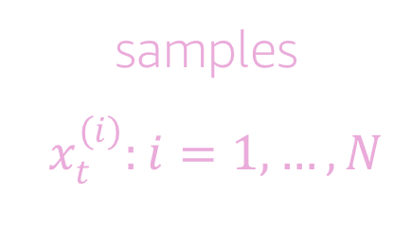

Monte Carlo Simulation
Closed-form Likelihood
$$l\left(x_{t_{0}:T}|θ \right)=\prod_{t=t_{0}}^{T}{l(x_{t}|θ)}$$
samples
$$x_{t}^{(i)}:i=1,…,N$$
state $x_{t}$
$$t$$
$$t+1$$
Time
Notes:
However, you can simulate many samples of the state’s potential trajectory at each time point, and then when the state’s next position is observed, you can weight each sample according to how likely it would have resulted in the state’s new position.

Slide 16
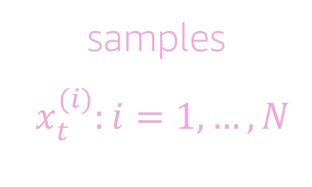
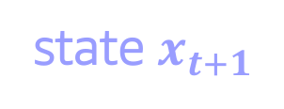


Monte Carlo Simulation
Closed-form Likelihood
$$l\left(x_{t_{0}:T}|θ \right)=\prod_{t=t_{0}}^{T}{l(x_{t}|θ)}$$
samples
$$x_{t}^{(i)}:i=1,…,N$$
Monte Carlo Likelihood
state $x_{t}$
$$\hat{l}\left(x_{t}^{(1:N)}|θ \right)=\frac{1}{N}\sum_{i=1}^{N}{w(x_{t}^{(i)})}$$
state $x_{t+1}$
$$t$$
$$t+1$$
Time
Notes:
The samples gives an empirical distribution of the state, in other words, a probabilistic forecast of the state.
Say the number of samples you choose to generate is $N$. The greater $N$ is, the closer your empirical approximation is to the state’s true probability distribution. As $N$ tends to infinity, the true probability distribution is recovered exactly.

Slide 17

Monte Carlo Simulation
Closed-form Likelihood
$$l\left(x_{t_{0}:T}|θ \right)=\prod_{t=t_{0}}^{T}{l(x_{t}|θ)}$$
samples
$$x_{t}^{(i)}:i=1,…,N$$
Monte Carlo Likelihood
state $x_{t}$
$$\hat{l}\left(x_{t}^{(1:N)}|θ \right)=\frac{1}{N}\sum_{i=1}^{N}{w(x_{t}^{(i)})}$$
state $x_{t+1}$
‘Exact’
$$\lim_{N→∞}{\hat{l}\left(x_{t_{0}:T}^{(1:N)}|θ \right)=l\left(x_{t_{0}:T}|θ \right)}$$
$$t$$
$$t+1$$
Time
Notes:
Of course, increasing $N$ means increased simulation, that is, increased computational effort. For this reason, Monte Carlo methods are called ‘exact’, because an arbitrary amount of precision can be achieved by increasing computational effort.

Slide 18
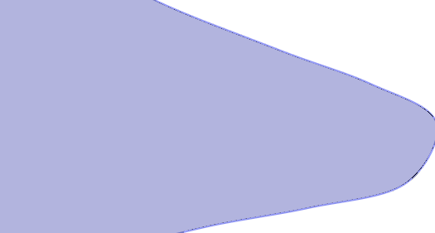


Monte Carlo Simulation
Order the MC samples
$x_{t}^{(i)}<$ $x_{t}^{(i+1)}$
samples
$$x_{t}^{(i)}:i=1,…,N$$
state $x_{t}$
Confidence Interval
$$90\% :\left[ x_{t+1}^{(\left\lfloor 0.5∙N\right\rfloor )},x_{t+1}^{(\left\lceil 0.95∙N\right\rceil )}\right]$$
state $x_{t+1}$
$$t$$
$$t+1$$
Time
Notes:
Monte Carlo samples also provide you a confidence interval. Suppose you’ve simulated $N$=1000 samples. Ordering these samples from least to greatest, you can then take the 50th ordered sample and the 950th ordered sample and know that 90% of the simulated paths fall between these two values. This provides us a 90% confidence interval.
Monte Carlo confidence intervals are nice for real-world problems because they overcome parametric assumptions like symmetry.

Slide 19





DeepAR Likelihood Models
Distribution | Data scenario | Likelihood
gaussian | Real-valued data
negative-binomial | Count data (non-negative integers)
beta | Real-valued targets between 0 and 1 inclusive
student-t | Alternative for real-valued data, works well for bursty data.
deterministic-L1 | Loss function, does not estimate uncertainty, learns only a point forecast.
$$\frac{1}{\sqrt{2πσ^{2}}}e^{\left\{\frac{−{(z−μ)}^{2}}{2σ^{2}}\right\}}$$
$$\frac{Γ\left(z+\frac{1}{α}\right)}{Γ(z+1)Γ\left(\frac{1}{α}\right)} {\left(\frac{1}{1+αμ}\right)}^{\frac{1}{α}}{\left(\frac{αμ}{1+αμ}\right)}^{z}$$
$$\frac{z^{α−1}{\left(1−z\right)}^{β}}{B(α,β)}$$
$$\frac{Γ\left(\frac{ν+1}{2}\right)}{\sqrt{νπ}Γ\left(\frac{ν}{2}\right)}{\left(1+\frac{z^{2}}{2}\right)}^{− \frac{ν+1}{2}}$$
$$\left|z−\hat{z}\right|$$
Notes:
DeepAR has expanded to handle many different likelihood models.
The middle column in this table indicates when to use the different likelihoods. In the right column, you see the likelihood formula associated with each distribution – DeepAR handles the activation parameterization and optimization of each of the likelihoods, on your behalf.

Slide 20

DeepAR Likelihood Models
Distribution | Data scenario | Likelihood
gaussian | Real-valued data
negative-binomial | Count data (non-negative integers)
beta | Real-valued targets between 0 and 1 inclusive
student-t | Alternative for real-valued data, works well for bursty data.
deterministic-L1 | Loss function, does not estimate uncertainty, learns only a point forecast.
$$\frac{1}{\sqrt{2πσ^{2}}}e^{\left\{\frac{−{(z−μ)}^{2}}{2σ^{2}}\right\}}$$
$$\frac{Γ\left(z+\frac{1}{α}\right)}{Γ(z+1)Γ\left(\frac{1}{α}\right)} {\left(\frac{1}{1+αμ}\right)}^{\frac{1}{α}}{\left(\frac{αμ}{1+αμ}\right)}^{z}$$
$$\frac{z^{α−1}{\left(1−z\right)}^{β}}{B(α,β)}$$
$μ$ and $α$ are both output of a dense layer with softplus activation
$α$ scales variance relative to the mean
$$\frac{Γ\left(\frac{ν+1}{2}\right)}{\sqrt{νπ}Γ\left(\frac{ν}{2}\right)}{\left(1+\frac{z^{2}}{2}\right)}^{− \frac{ν+1}{2}}$$
$$\left|z−\hat{z}\right|$$
Notes:
For example, for the negative-binomial distribution, $μ$ and $α$ are formulated as outputs of a dense layer using softplus activation, with $α$ then scaling the variance relative to the mean.
For more information about DeepAR likelihood models, see DeepAR Hyperparameters.

Slide 21
Module 2 Topics
Overview of Amazon SageMaker
Amazon SageMaker DeepAR
LSTM-parameterized Likelihood
Monte Carlo Simulation
Lab: DeepAR for Forecasting
Notes:
That wraps up the presentation aspect of Module 2. You will now have an opportunity to actually use the DeepAR algorithm by participating in another hands-on lab.

Slide 22

Lab 2: Forecasting with DeepAR
Multi-step Ahead Prediction
Autoregressive Forecasting
Probabilistic Forecasting
Multiple Time Series
You will be using the DeepAR algorithm to forecast twitter volume
80% confidence in this data range about the point forecast
Notes:
In this next lab, use the DeepAR algorithm to forecast electricity demand (across different dimensions) based on a time series of past consumption.
Note on License of Lab Dataset
For this lab, you will be using an open source dataset entitled “Individual Household Electric Power Consumption” that comes from the UCI Machine Learning Repository. Information about the dataset license can be found below.
The MIT License (MIT) Copyright © [2017] Zalando SE, https://tech.zalando.com
THE SOFTWARE IS PROVIDED “AS IS”, WITHOUT WARRANTY OF ANY KIND, EXPRESS OR IMPLIED, INCLUDING BUT NOT LIMITED TO THE WARRANTIES OF MERCHANTABILITY, FITNESS FOR A PARTICULAR PURPOSE AND NONINFRINGEMENT. IN NO EVENT SHALL THE AUTHORS OR COPYRIGHT HOLDERS BE LIABLE FOR ANY CLAIM, DAMAGES OR OTHER LIABILITY, WHETHER IN AN ACTION OF CONTRACT, TORT OR OTHERWISE, ARISING FROM, OUT OF OR IN CONNECTION WITH THE SOFTWARE OR THE USE OR OTHER DEALINGS IN THE SOFTWARE.
Image Attribution
Image of Bell Curve by Davo Sime from the Noun Project, accessed from: https://thenounproject.com/icon/614251/

